Slide 1
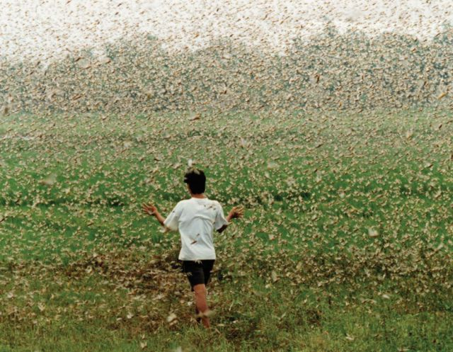
Bugs
Don’t live with them
Don’t fix them
Prevent them
Prove everything

Slide 2
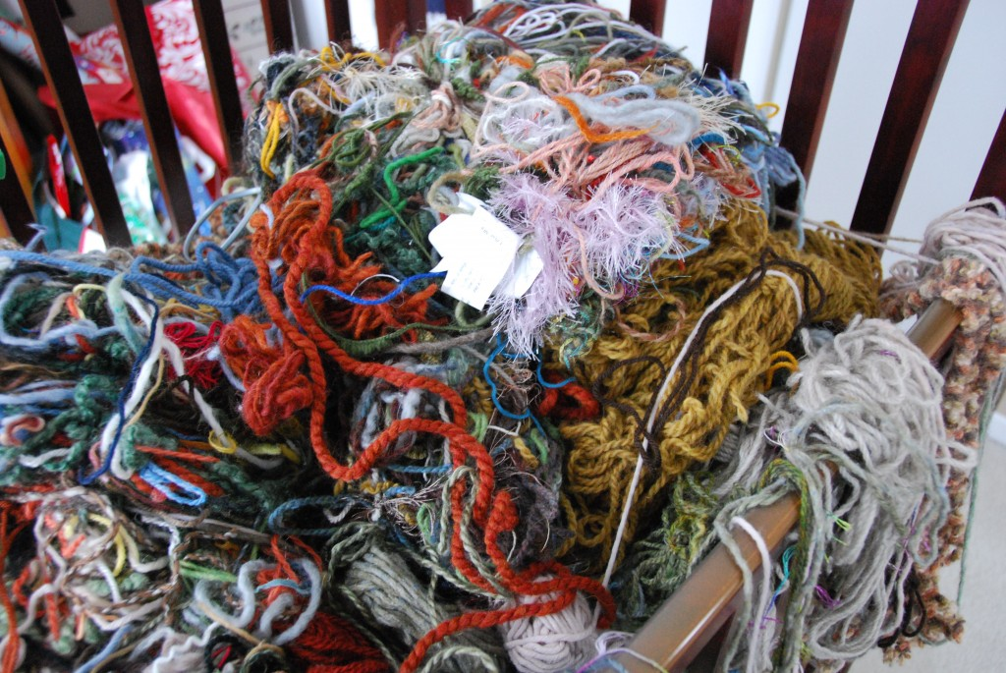
Good design
+
30 years of
careful changes
Notes:
Word team, decisions starting in late 80s

Slide 3

Learn from each bug to prevent more
Notes:
Nancy V. Global variables.
How many bugs do you think it caused? 1. Because they learned the cause and fixed the code.

Slide 4

Notes:
Bugs come from errors, and errors come from information we can’t take into account

Slide 5

Essential
Complexity
Incidental
Complexity
Notes:
Most of the complexity is incidental

Slide 6
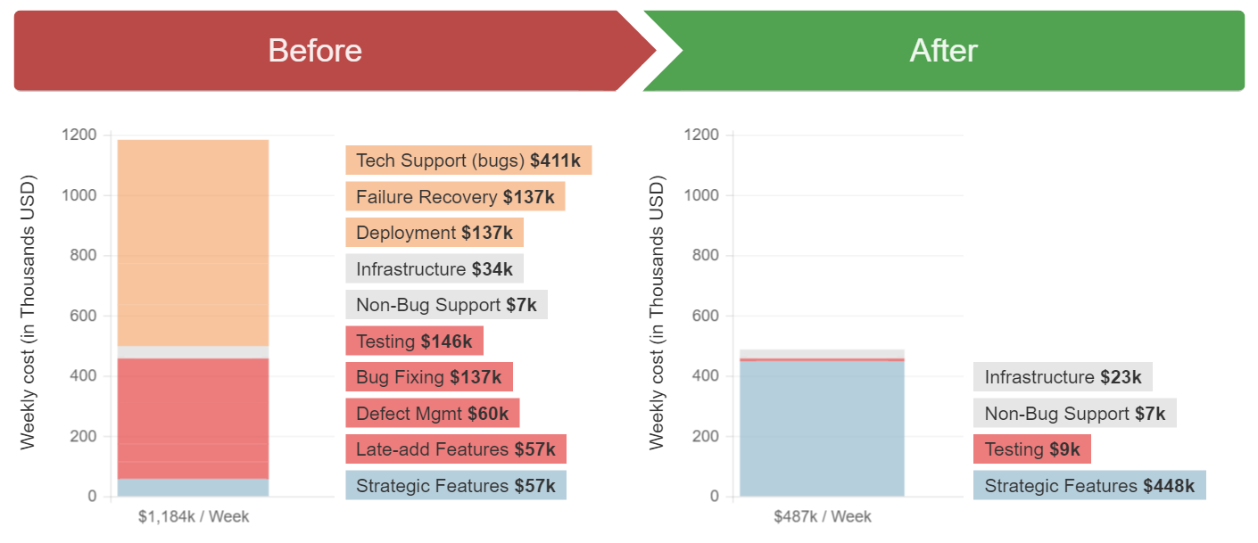
Notes:
Holding cost of bugs

Slide 7
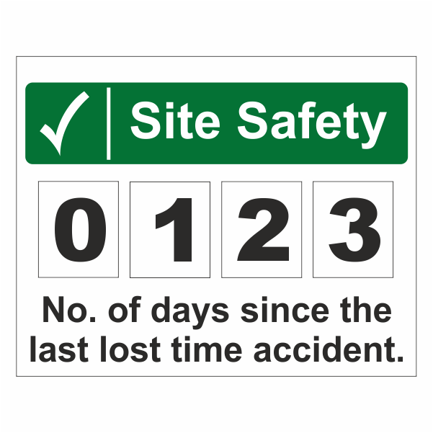
Notes:
Brian G team – how they report & handle bugs.

Slide 8
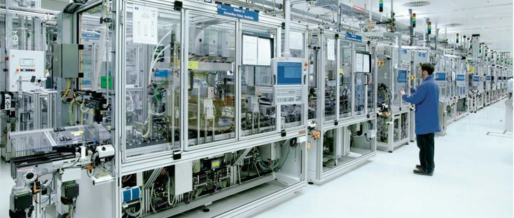
Notes:
Hunter story: data on which screen

Slide 9
Notes:
Exercise: Simplify; replace process with discipline. Don’t just prove it, also mistake-proof it. Lead them to find ways to prove their work in better and better ways

Slide 10
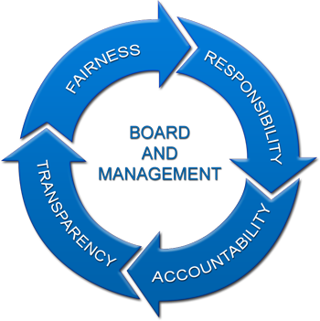
Power &
Trust
Own your destiny
Replace governance
with trust

Slide 11


Manager
+
commands
Doer
Worker
Scientific Management
Founded in Governance
Lean Working
Founded in Trust

Slide 12
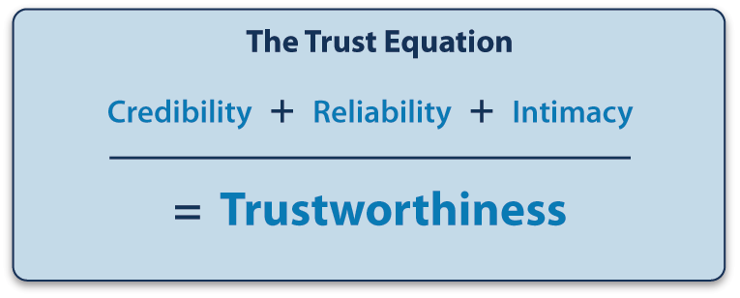

Slide 13
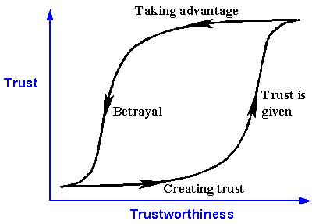
Notes:
Just because you are sincere doesn’t relieve you from sounding sincere

Slide 14
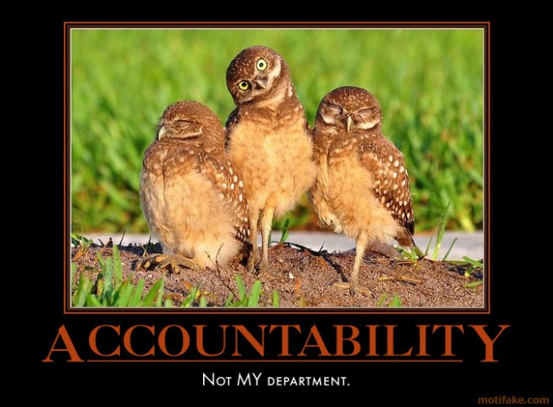
Notes:
Group accountability

Slide 15
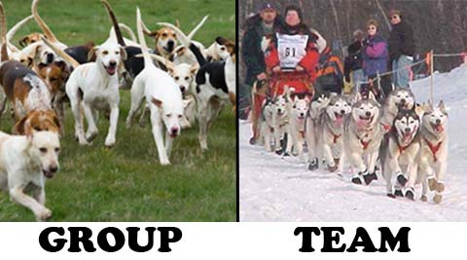
Notes:
Peeve #1: calling everything a team

Slide 16

Notes:
Peeve #2: empowerment

Slide 17

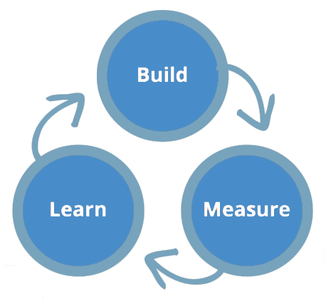

Tradition
Authority
Oligarchy
0 Brains
1 Brain
Select Brains
Democracy
Consent
Consensus
Majority of Brains
All Brains
All Brains

Slide 18

Notes:
Individual roles: for important stuff or for irrelevant stuff?

Slide 19
Notes:
Exercise: Define future/optimal roles. What does team own, what does management own?

Slide 20
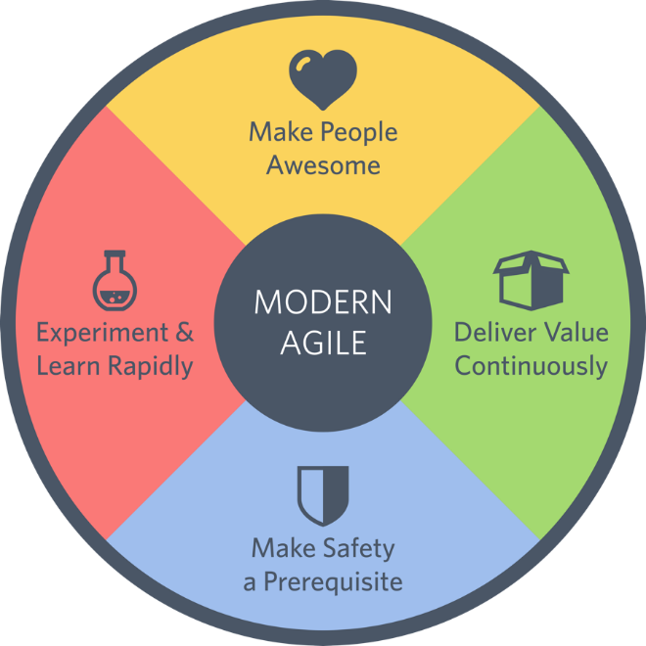
Modern Agile
Applied
Pragmatic values

Slide 21
Notes:
4 values. Quick description. But also: these are pragmatic, meant to be directly applied.

Slide 23
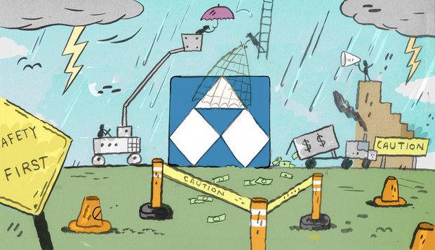
Notes:
Alcoa turnaround story

Slide 25

Notes:
Not just users. Make each other badass too.

Slide 27

Notes:
Story: convert ColdFusion to .Net, while adding features and shipping every hour

Slide 29
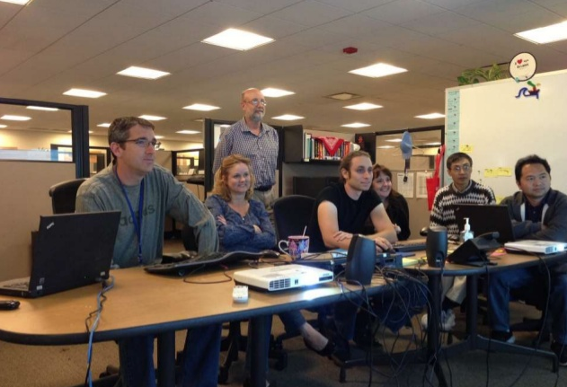
Notes:
Yes, they’re programming. This is experiment and learn rapidly. 50 products, one team, 2 full product releases per day (plan, code, ship, feedback from customers)

Slide 30
Notes:
Exercise: radar chart, lowest then highest, 15% solutions

